Slide 1
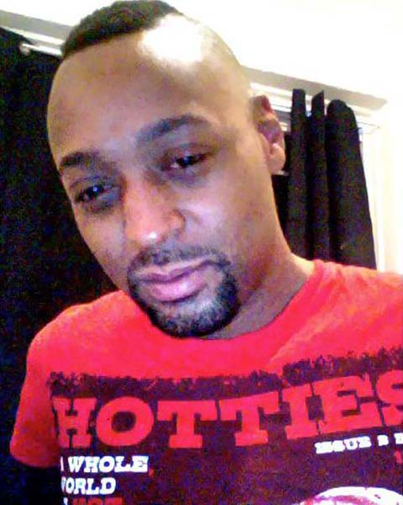
Son
Brother
HUMAN
Friend
Neighbor

